Slide 1
E-commerce Product Delivery Prediction
Presented By: David Jose

Slide 2
Agenda:
Project Introduction
Business Goals and Benefits
Dataset Overview
Exploratory Data Analysis(EDA)
Model Selection and Training
Model Evaluation
Conclusion and Future Scope
Feature Engineering

Slide 3

Introduction
This project aims to enhance the understanding of product delivery patterns and customer behavior for an international e-commerce company specializing in electronic products. By leveraging machine learning, the project seeks to predict whether products will reach customers on time. The goal is to develop robust machine learning models to accurately predict product delivery timeliness, enabling the company to improve customer satisfaction, optimize logistics, and gain insights into factors affecting delivery performance.

Slide 4
Business Goals and Benefits
Business Goals:
Use machine learning to predict if a delivery will be on time
Find out what causes delays in delivery
Help the company plan better for shipping and customer service
Key Benefits:
Delivery Optimization:Find out what causes delays and improve shipping plans for faster deliveries.
Customer Satisfaction:Predict delivery times accurately to set clear expectations and reduce complaints.
Operational Insights:Learn from data about products, shipping, and customers to make better business decisions.

Slide 5
Machine Learning Workflow
Data Collection
Exploratory Data Analysis
Preprocessing
Split Train And Test Data
Model Selection and
Model Training
Model Evaluation
Visualization
Gather the dataset containing delivery details.
Analyzing and visualizing data to understand its patterns , trends, and key characteristics.
Clean the data by fixing missing values, encoding categories and creating new features.
Divide the data into two parts : One for training the model and one for testing it.
Choose different machine learning models and train them using the training data.
Check how well the models work using accuracy, precision, recall ,etc…
Use graphs to show insights and how well the models are performing.

Slide 6

Dataset Overview
Dataset Size and Structure
The e-commerce delivery dataset comprises 10,999 rows and 12 columns, providing detailed customer and order-related information.
Target Variable
The target variable 'Reached.on.Time_Y.N' indicates if a delivery was timely (0) or late (1).
Key Features
Important features include warehouse block, shipment mode, customer care calls, customer rating, product cost, prior purchases, product importance, customer gender, discount offered, and product weight.
Notes:
The e-commerce delivery dataset contains 10,999 rows and 12 columns, detailing customer and order-related information. The target variable 'Reached.on.Time_Y.N' indicates timely delivery (1) or late delivery (0). Key features include warehouse block, shipment mode, customer care calls, customer rating, product cost, prior purchases, product importance, customer gender, discount offered, and product weight.

Slide 7
Key Features Description
Feature | Description
ID | Unique ID number of each customer
Warehouse_block | Warehouse block where the product was stored (A, B, C, D, E)
Mode_of_Shipment | Shipping method: Ship, Flight, or Road
Customer_care_calls | Number of calls made to customer care about the shipment
Customer_rating | Customer’s rating (1 = Worst, 5 = Best)
Cost_of_the_Product | Price of the product (in USD)
Prior_purchases | Number of previous purchases by the customer
Product_importance | Product priority level: low, medium, or high
Gender | Gender of the customer (Male / Female)
Discount_offered | Discount given on the product
Weight_in_gms | Weight of the product in grams
Reached.on.Time_Y.N | Target Variable: 1 = Not on time, 0 = On time

Slide 8
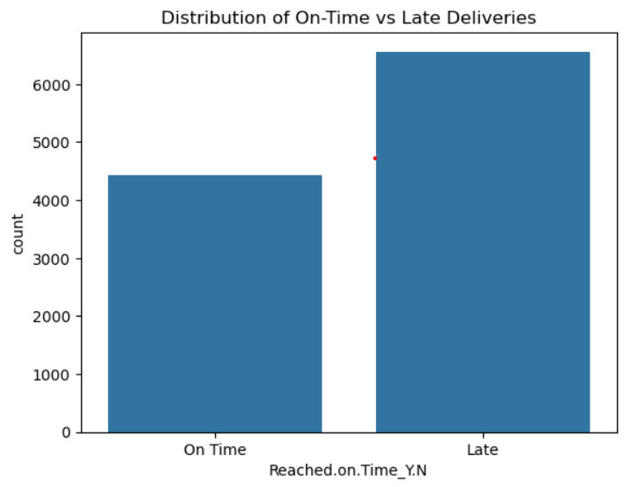
Exploratory Data Analysis (EDA)
Distribution of On-Time vs Late Deliveries
The number of late deliveries is higher than on-time
deliveries.
There are significantly more late deliveries than on-time ones. This suggests potential issues in the supply chain or shipping process that need to be addressed.

Slide 9
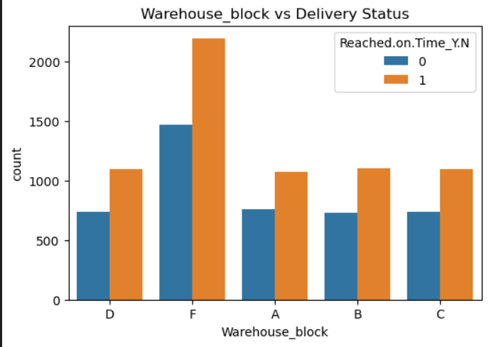
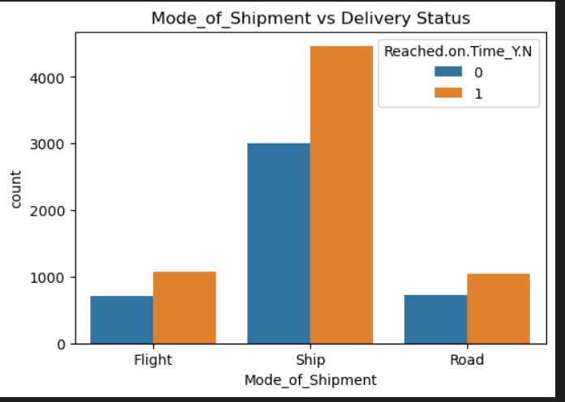
Ship is the most commonly used mode but also shows a higher number of late deliveries.
Flight deliveries are generally faster and more often on time, though used less frequently.
Some blocks (e.g., Block F ) may have more late deliveries than others.
This could indicate operational delays, location issues, or staff inefficiency in those specific blocks.

Slide 10
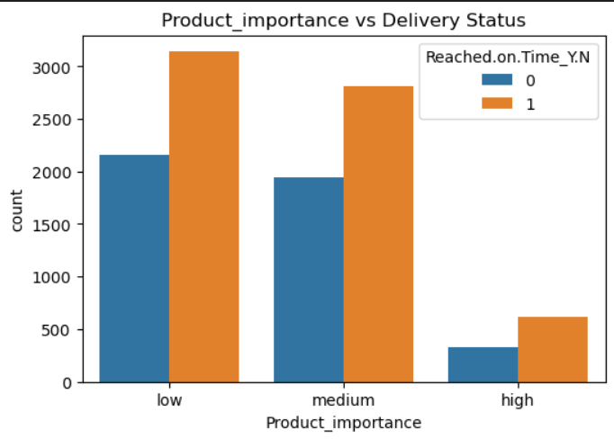
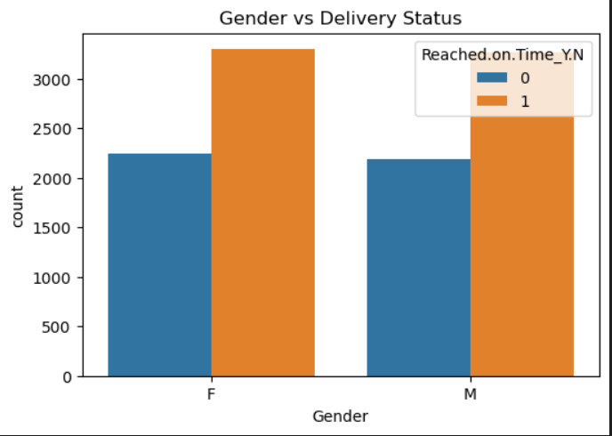
Low importance products have the highest number of late deliveries.
This indicates that product priority plays a key role in how efficiently deliveries are managed.
Both male and female customers experience late deliveries, but the numbers are fairly close.

Slide 11
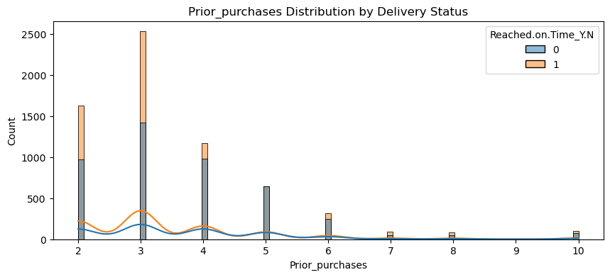
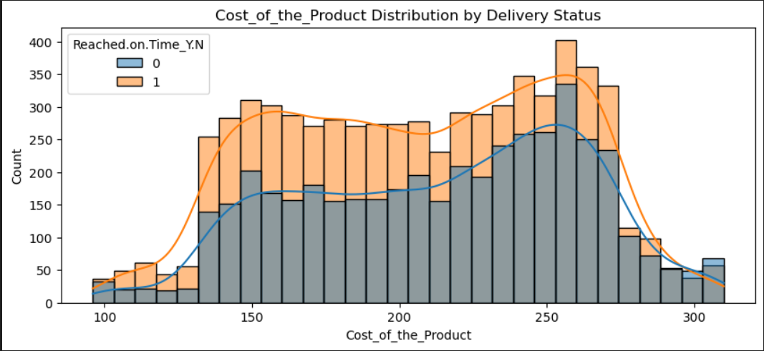
For Prior Purchases = 2, 3, 4:Late deliveries are more frequent than on-time deliveries.
However, on-time deliveries are still significantly present, showing moderate reliability.
The trend suggests that delivery performance improves slightly for repeat customers, especially those with 4 or more prior purchases.
The cost distribution reveals that both on-time and late deliveries occur across all price levels, though higher-priced items show a slightly better on-time performance.

Slide 12
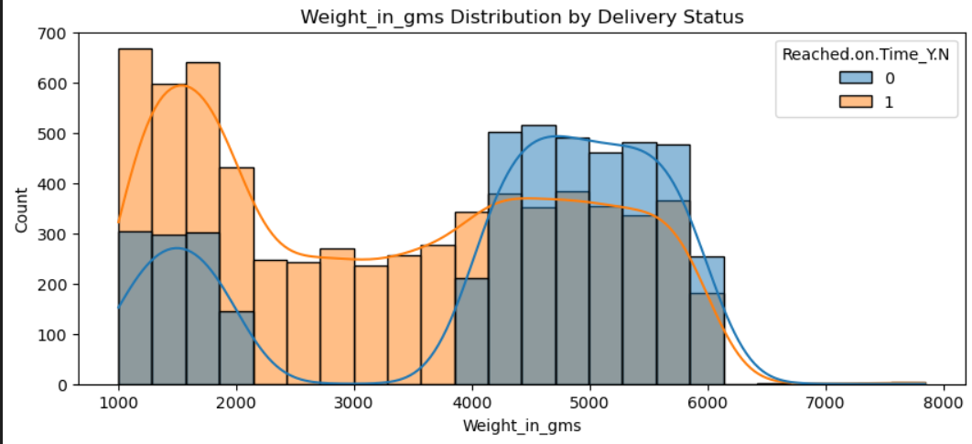
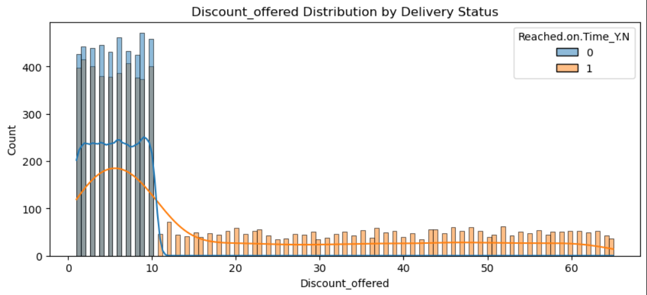
Heavier products (higher weight in grams) show a greater number of on-time deliveries.
Lighter products have a relatively higher proportion of late deliveries.
Surprisingly, the analysis shows that products with higher weights are more likely to be delivered on time, possibly due to more structured shipping methods for heavier items.
High discount items tend to have more late deliveries.
Low discount items are more likely to be delivered on time.
High discount items often face delivery delays due to higher demand, logistics overload, and lower prioritization.

Slide 13
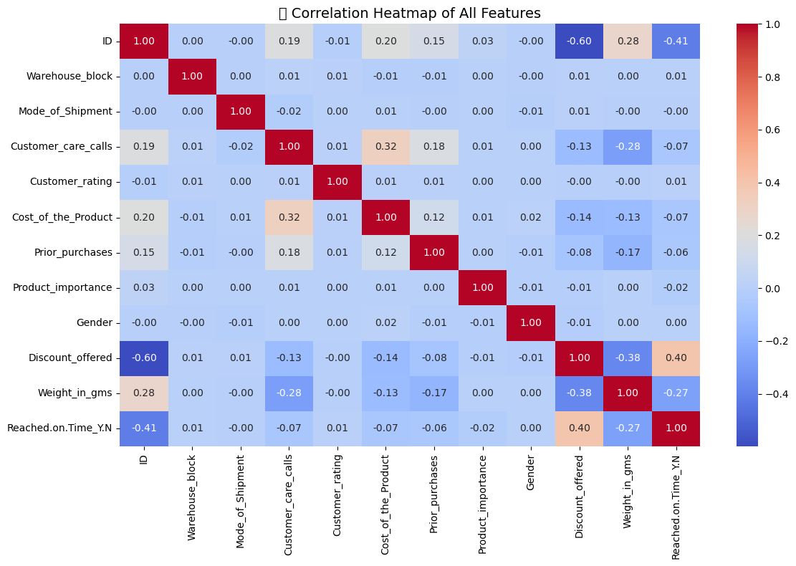
Values range from -1 to 1:
+1: Perfect positive correlation (move together)
-1: Perfect negative correlation (move oppositely)
0: No linear relationship
Discount Offered(Correlation:+0.40): Higher discounts are moderately associated with more late deliveries, likely due to increased order volume and strain during promotions.
Weight in Grams (Correlation:−0.27): Heavier products are more likely to be delivered on time, possibly due to better handling, packaging, or prioritization in logistics.

Slide 14
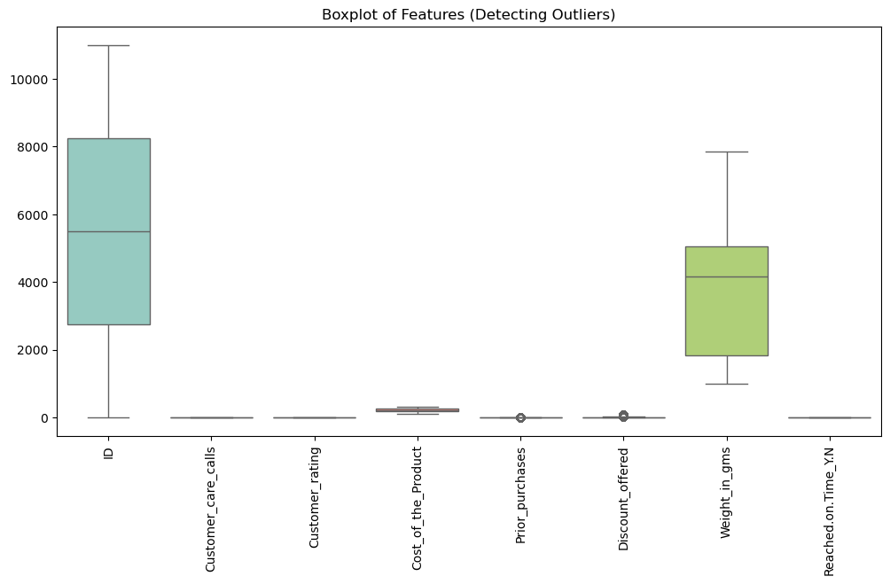
The feature Weight_in_gms exhibits several high-value outliers, indicating some products are significantly heavier than others. These outliers may affect model performance and should be carefully analyzed or transformed during preprocessing.

Slide 15
Feature Engineering and Data Preparation
Created new features: discount_ratio, weight_cost_ratio
Encoded categorical variables using One-Hot Encoding
Scaled numerical features with StandardScaler
Split data: 80% training, 20% testing (stratified)

Slide 16
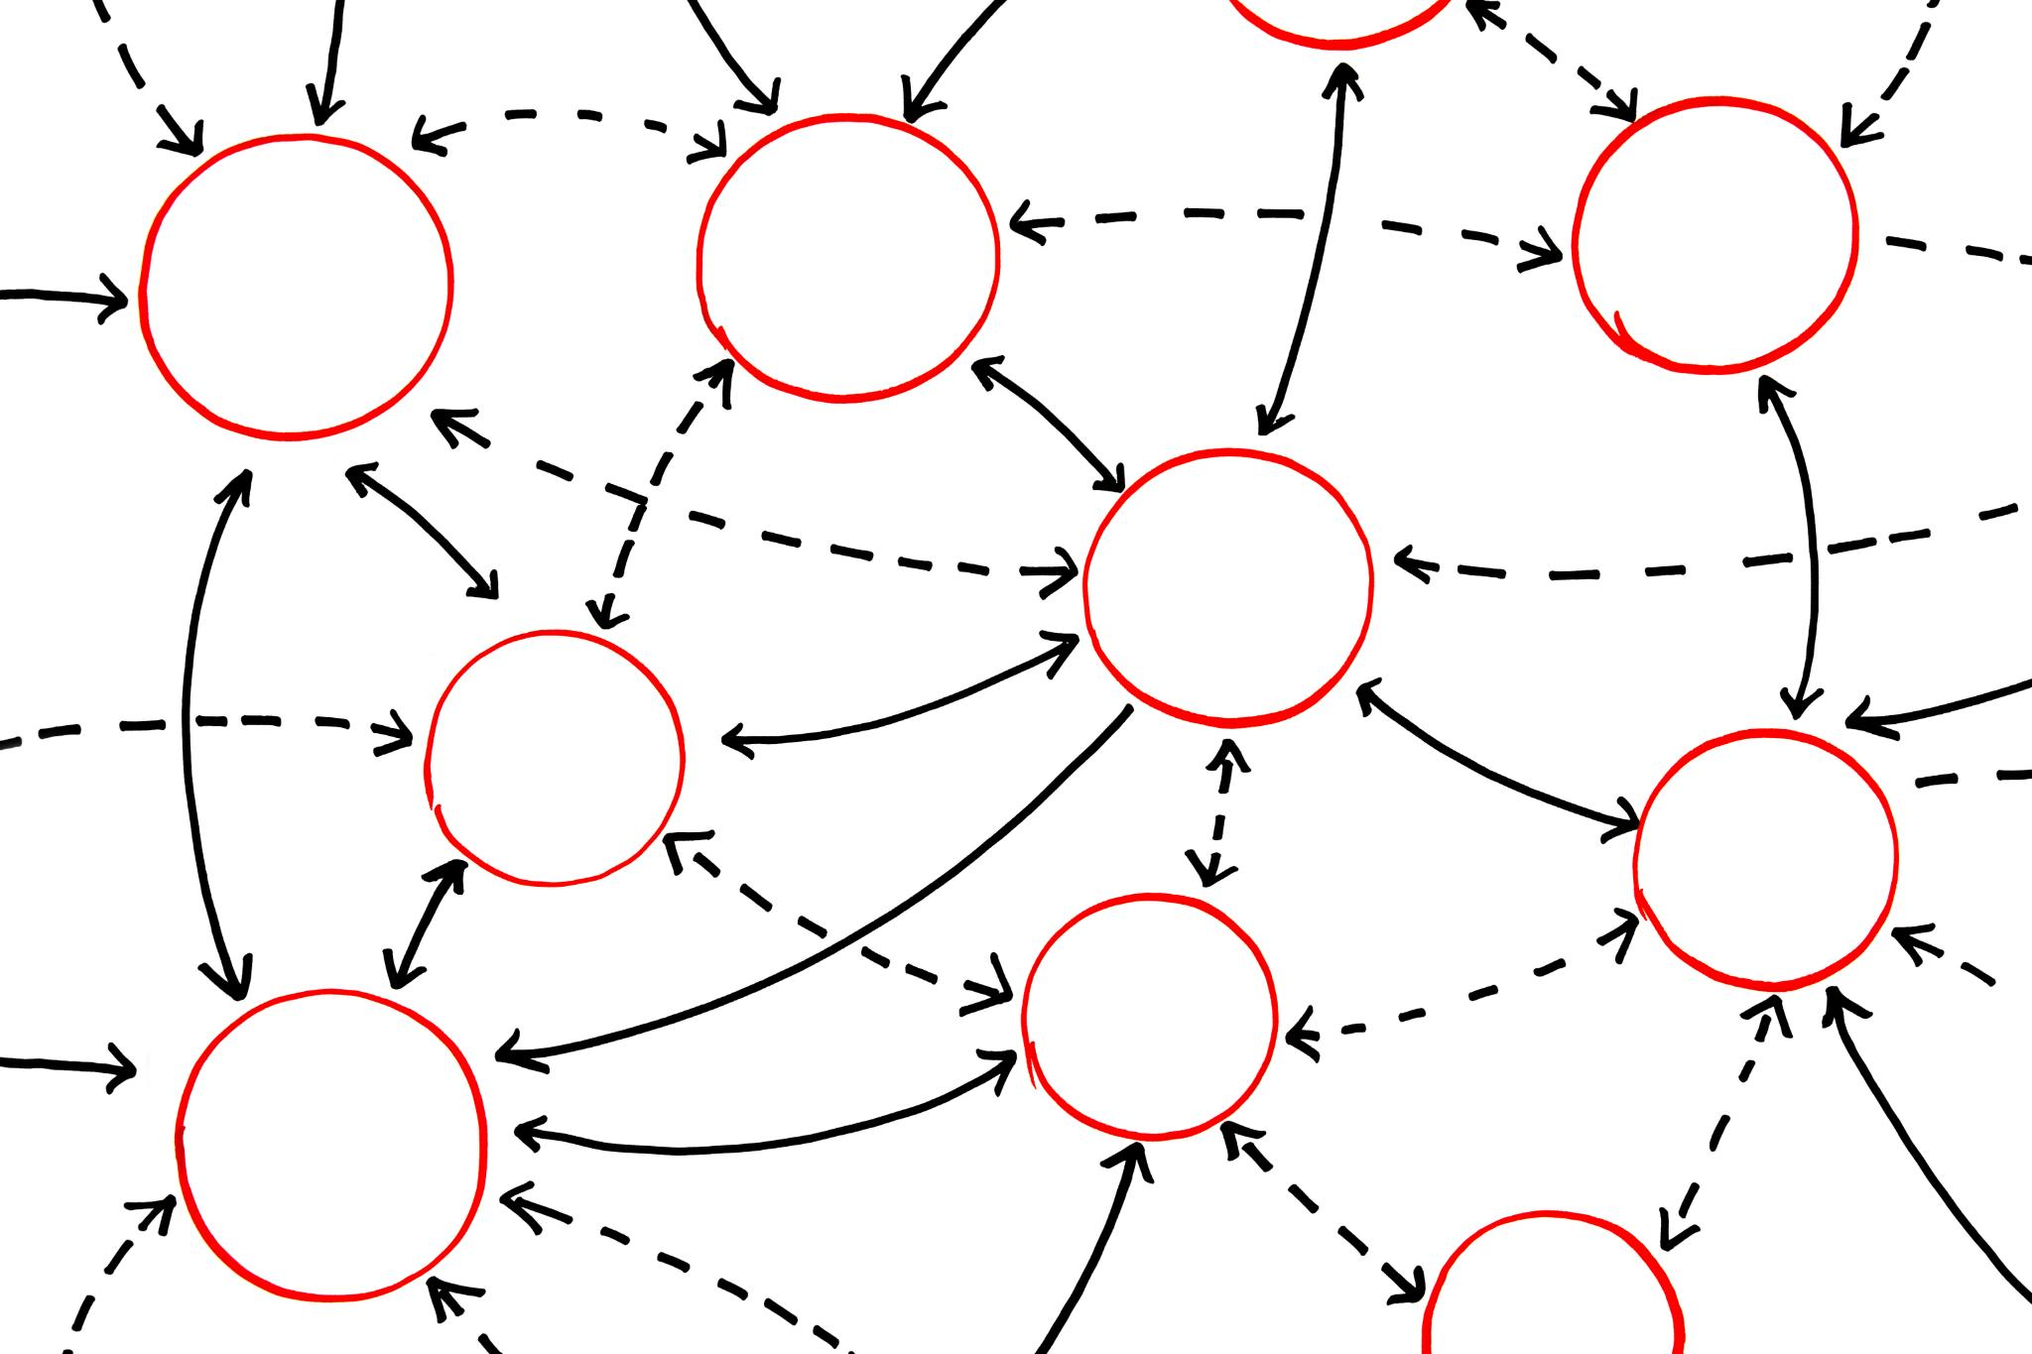
Model Selection & Training
Logistic Regression
Logistic Regression is a simple, interpretable model for binary classification, making it easy to understand and implement.
Decision Tree
Decision Tree splits data based on feature values, forming a tree-like structure for decision making.
Random Forest
Random Forest, an ensemble of decision trees, improves accuracy and reduces overfitting by averaging multiple predictions.
K-Nearest Neighbors (KNN)
K-Nearest Neighbors (KNN) classifies based on the closest data points in the dataset, making decisions based on proximity.
Notes:
Choosing the right model is crucial for accurate predictions. Logistic Regression is a simple, interpretable model for binary classification. Decision Tree splits data based on feature values, forming a tree-like structure. Random Forest, an ensemble of decision trees, improves accuracy and reduces overfitting. K-Nearest Neighbors (KNN) classifies based on closest data points in the dataset.

Slide 17
Model Evaluation
Metrics for Evaluation:
Accuracy: The overall correctness of the model's predictions.
Precision: Out of all the deliveries predicted as late, how many were actually late
Recall: Out of all the actual late deliveries, how many the model caught correctly
F1-Score: A measure that balances precision and recall.
Confusion Matrix: A tool that compares true values against predicted values for both categories (on-time and late).
​

Slide 18
Model Comparison Summary
Model | Accuracy | Precision |  | Recall |  | F1-Score
 |  | On Time | Late | On Time | Late | On Time | Late
Logistic Regression | 0.64711 | 0.56 | 0.72 | 0.61 | 0.67 | 0.58 | 0.69
Decision Tree | 0.6653 | 0.55 | 0.86 | 0.87 | 0.53 | 0.68 | 0.65
Random Forest | 0.67485 | 0.56 | 0.89 | 0.91 | 0.52 | 0.69 | 0.65
KNN | 0.6502 | 0.56 | 0.73 | 0.66 | 0.65 | 0.60 | 0.69

Slide 19
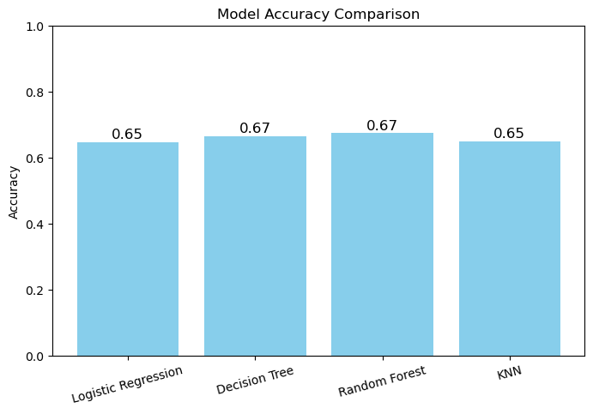
Best Performing Model: Random Forest
Random Forest achieved the highest test accuracy (67.49%) and excellent precision for predicting late deliveries (0.89). It provides the best balance between performance and reliability for this task.

Slide 20
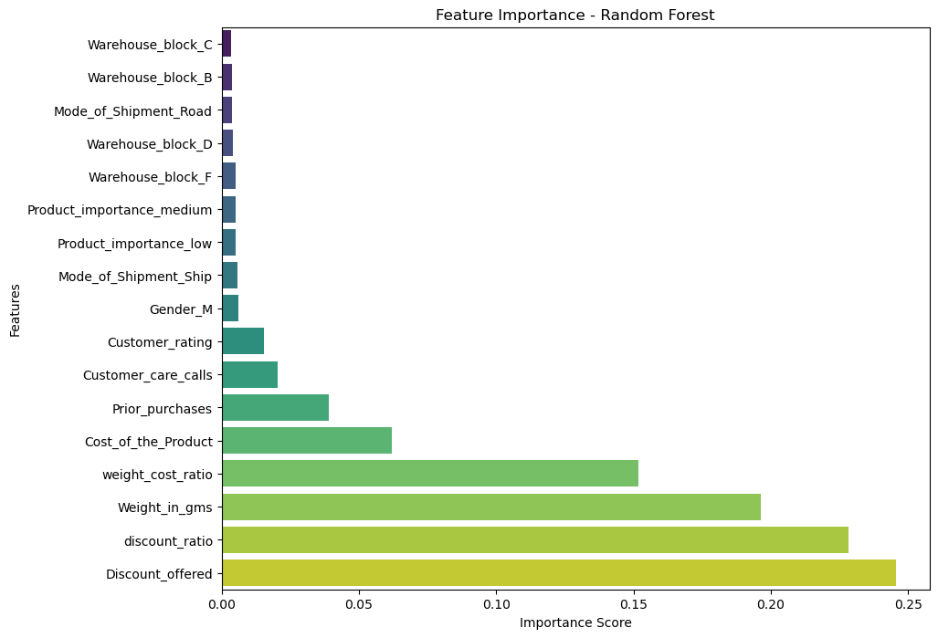
Feature importance refers to how much each input feature contributes to a machine learning model's prediction.
Discount Offered: Highest importance, possibly due to its impact on shipping load and delays.
Weight in gms: A key factor influencing logistics and delivery time.

Slide 21
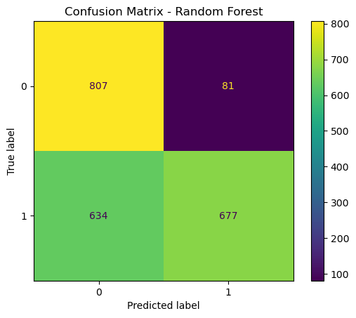
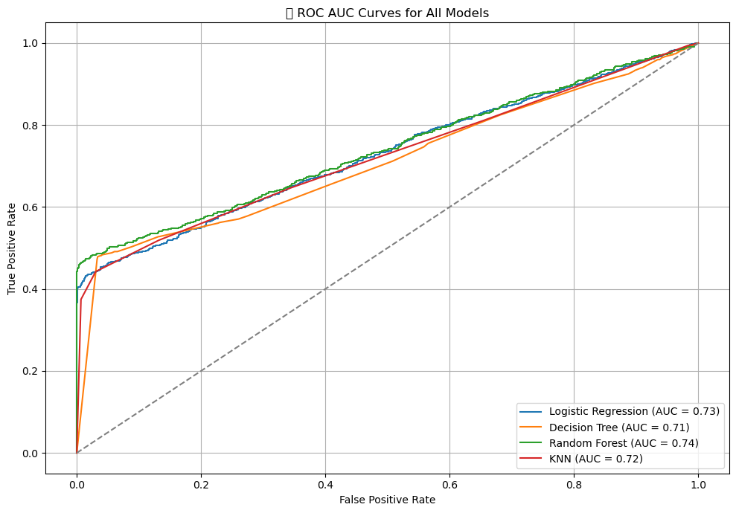
807 deliveries were correctly predicted as on time (True Negative).
677 deliveries were correctly predicted as late (True Positive).
81 on-time deliveries were incorrectly predicted as late (False Positive).
634 late deliveries were incorrectly predicted as on time (False Negative).
AUC tells us how good the model is at separating on-time and late deliveries.
The closer the AUC is to 1.0, the better.
Random Forest achieved the highest AUC, indicating the best ability to distinguish between on-time and late deliveries.

Slide 22
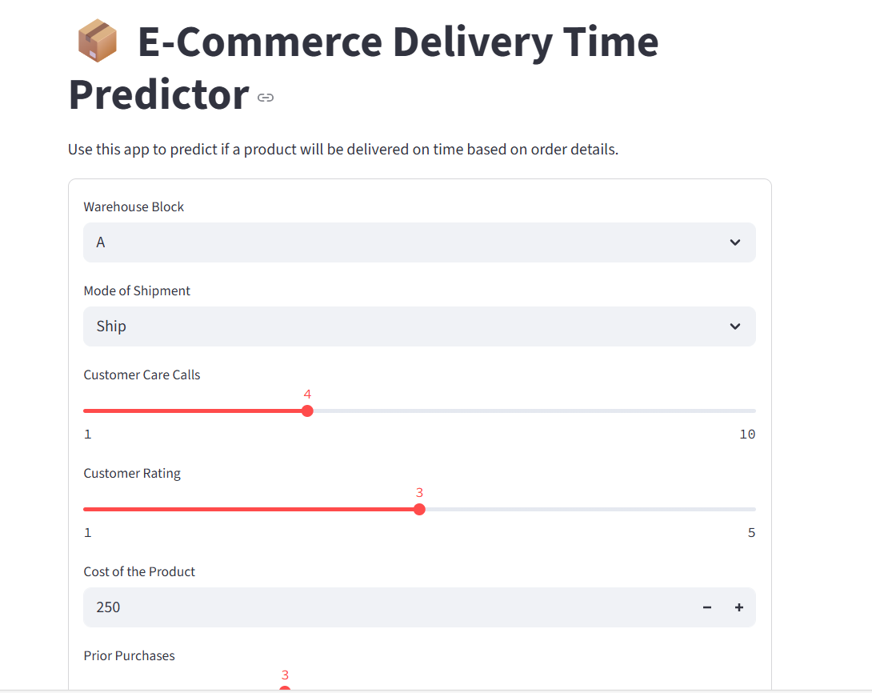
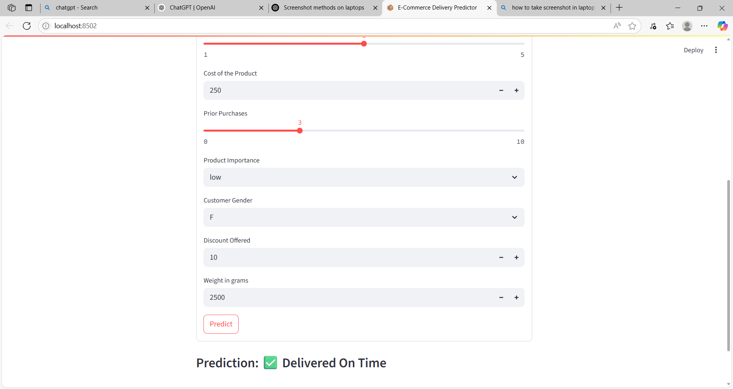
Model Deployment on Streamlit

Slide 23
Conclusion
Developed and evaluated multiple classification models to predict on-time vs late deliveries.
Random Forest delivered the best performance with 67.49% accuracy and high precision (0.89) for predicting late deliveries.
The delivery prediction model enables the e-commerce company to make data-driven decisions that improve both operational efficiency and customer satisfaction. By accurately identifying potential late deliveries, the business can:
Proactively address delays before they affect the customer
Optimize shipping routes and logistics based on key influencing factors
Allocate resources more efficiently (e.g., warehousing, shipment modes)
Set realistic delivery expectations to reduce customer complaints
Gain valuable insights into product, customer, and shipping patterns
Ultimately, this predictive system supports a smarter, faster, and more reliable delivery experience, helping the company maintain a competitive edge in a fast-paced market.

Slide 24
Limitations
The model’s performance is limited by the quality and size of the dataset.
Some features showed low predictive power.
The model may not fully generalize to different product categories or seasonal variations.
Future Scope
Expand the model with more diverse and real-world data for better accuracy.
Test and apply the solution in different regions or product categories.
Explore more advanced machine learning techniques for improved performance.
Integrate the model into the company's logistics system to support real-time decision-making.

Slide 25
Questions ?

Slide 26
Thank You!

